Slide 1
Predictive Modelling
Final Project: Exploring Mental Health Data
Presented By Alamelu Ramanathan

Slide 2
Problem Statement
Depression is a complex mental health condition influenced by a variety of factors, including demographic, lifestyle, and psychosocial variables. This study aims to identify and analyze key factors that contribute to the experience of depression in individuals, with the goal of uncovering patterns and potential risk factors. Understanding these relationships will help inform targeted interventions and support strategies to improve mental health outcomes.

Slide 3
Key Objectives
Prediction of Depression onset: Develop a machine learning model that can accurately classify individuals onset of depression.
Understand Key Drivers: Explore factors that may cause individuals to experience depression.
Actionable Insights: Use the findings to generate insights for healthcare system, policy makers, organizations, educational institutions and individuals to mitigate depression risk.

Slide 4
Exploratory Data Analysis
#2. Exploratory data analysis
dsTrain.info()
TARGET = 'Depression'
#Find the features with missing values
print(dsTrain.isnull().sum())
#Analyse the values in the demographics features
print (dsTrain['Age'].value_counts())
print(dsTrain['City'].value_counts())
print(dsTrain['Gender'].value_counts())
print(dsTrain['Profession'].value_counts())
print(dsTrain['Working Professional or Student'].value_counts())
#Aanlayse the values in psychosocial features
print(dsTrain['Financial Stress'].value_counts())
print(dsTrain['Job Satisfaction'].value_counts())
print(dsTrain['Study Satisfaction'].value_counts())
print(dsTrain['Academic Pressure'].value_counts())
print(dsTrain['Work Pressure'].value_counts())
print(dsTrain['Family History of Mental Illness'].value_counts())
print(dsTrain['Have you ever had suicidal thoughts ?'].value_counts())
Analyse the information in the mental health dataset , find the missing / null values if any and find ways to handle them.
Dataset has 140700 records with 20 columns that could be grouped under the following categories.
Individual demographics,
Lifestyle and
psychosocial information
On analysis it is found that there are more categorical features in the dataset and lot of noise is there.

Slide 5
Exploratory Data Analysis contd…
#Analyse the lifestyle features
print(dsTrain['Sleep Duration'].value_counts())
print(dsTrain['Dietary Habits'].value_counts())
print(dsTrain['Degree'].value_counts())
print(dsTrain['CGPA'].value_counts())
print(dsTrain['Work/Study Hours'].value_counts())
#Analyse age group in order with suicidal thoughts and depression
res = dsTrain[dsTrain['Have you ever had suicidal thoughts ?']=='Yes'].groupby(by = ['Age'])
print(res['Age'].value_counts().sort_values(ascending=False))
#Analyse the class imbalance
classCount= dsTrain['Depression'].value_counts()
print(f'class imbalance ratio , majority over minority class : {round(classCount[0]/classCount[1],2)} : 1')
classCount.to_frame().T
print(dsTrain[dsTrain['Job Satisfaction'].notnull() &
dsTrain['Study Satisfaction'].notnull()])
# F14 No merging conflicts with the pressure columns
dsTrain[dsTrain['Academic Pressure'].notnull() &
dsTrain['Work Pressure'].notnull()]
These are findings on analysis,
Id , name column seems irrelevant for our analysis
There are around 98 cities 64 professions with high cardinality features
pressure & satisfaction cols has scale from 1 to 5
Sleep duration, Dietary habits, Degree has noise
Age group with higher risk , 18 - 32!!!
job satisfaction and work satisfaction could be merged
Academic pressure and work pressure could be merged
There is no class imbalance as the the ratio is 1:4.5 for the target feature , Depression

Slide 6
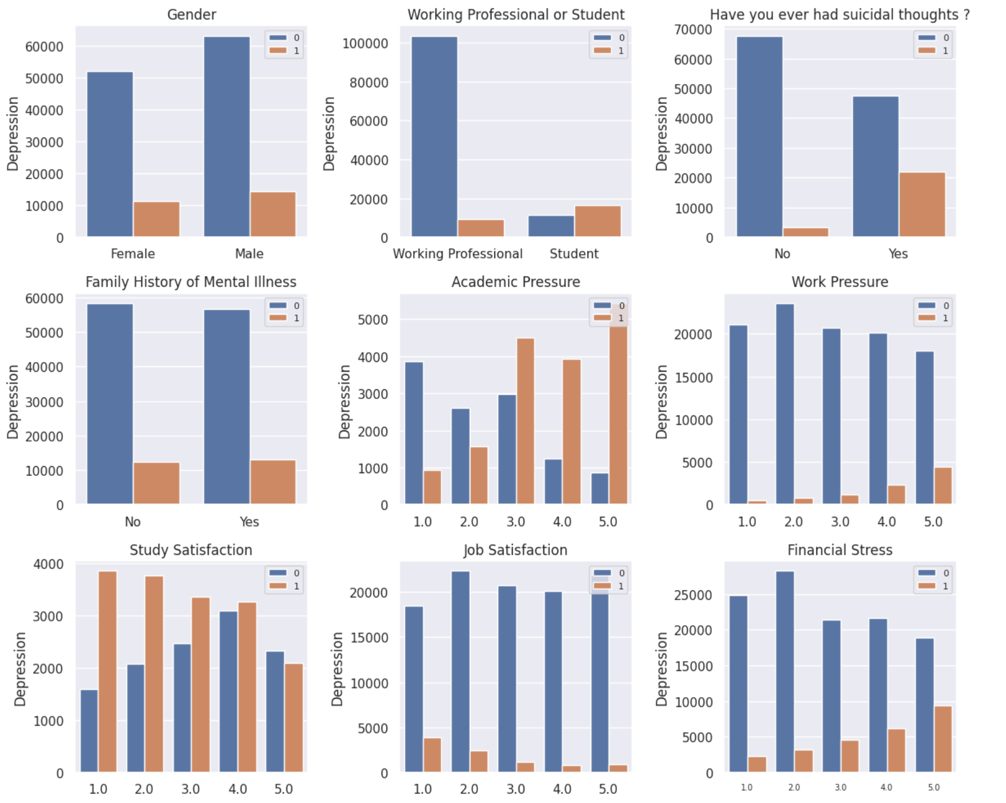
Visual Insights
Analysing the features against the target feature ‘Depression’ gives insights like,
Financial stress,
Work pressure
Academic pressure,
Suicidal thoughts,
Financial stress
contribute more to Depression.
Family mental history or no history have the same impact on the target.

Slide 7
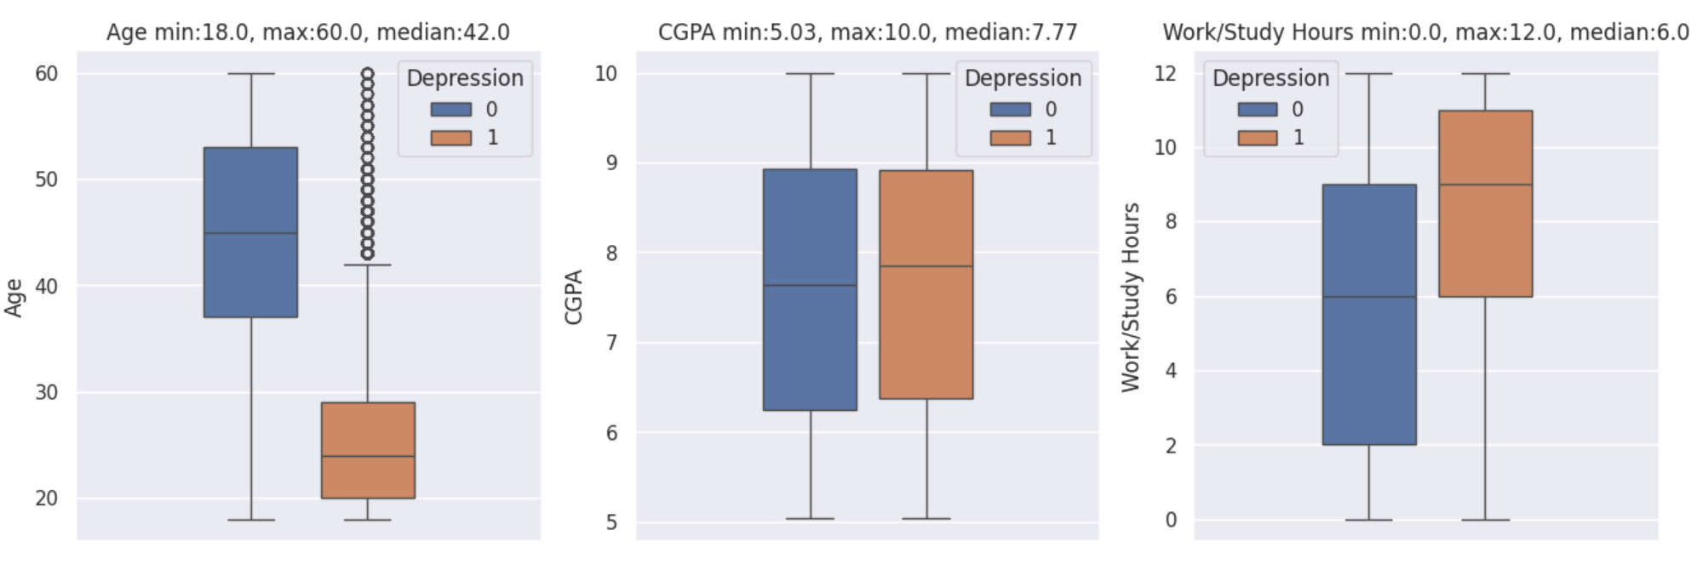
Visual Insights contd…
Box plot to visualize distribution of numerical variables in relation to the target class

Slide 8
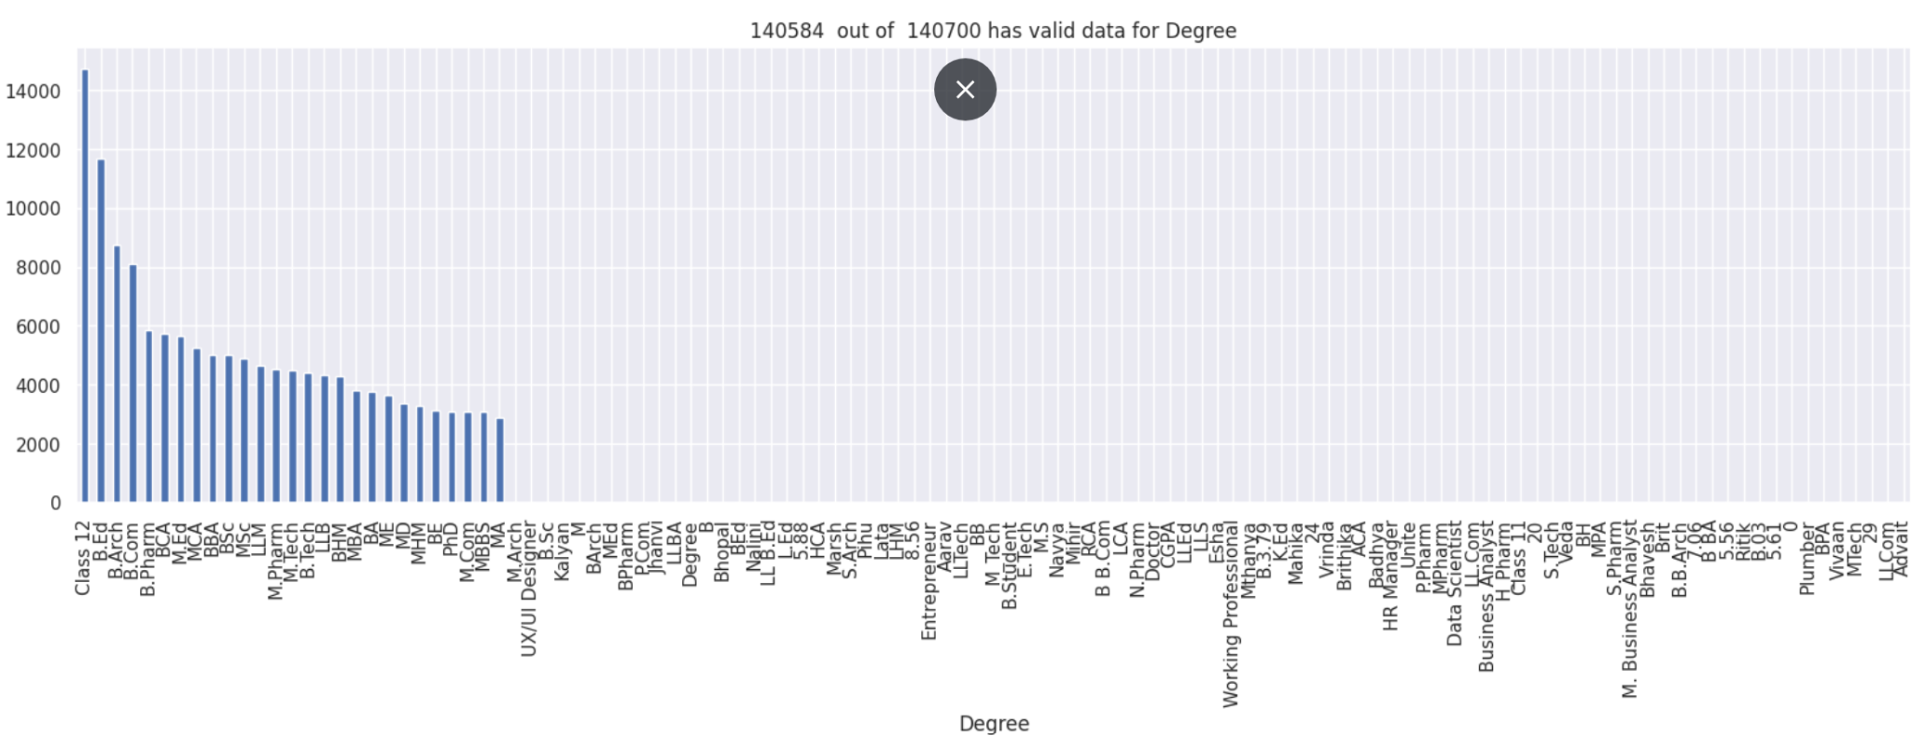
Visual Insights contd…
Bar plot to visualize high cardinality data with noises

Slide 9
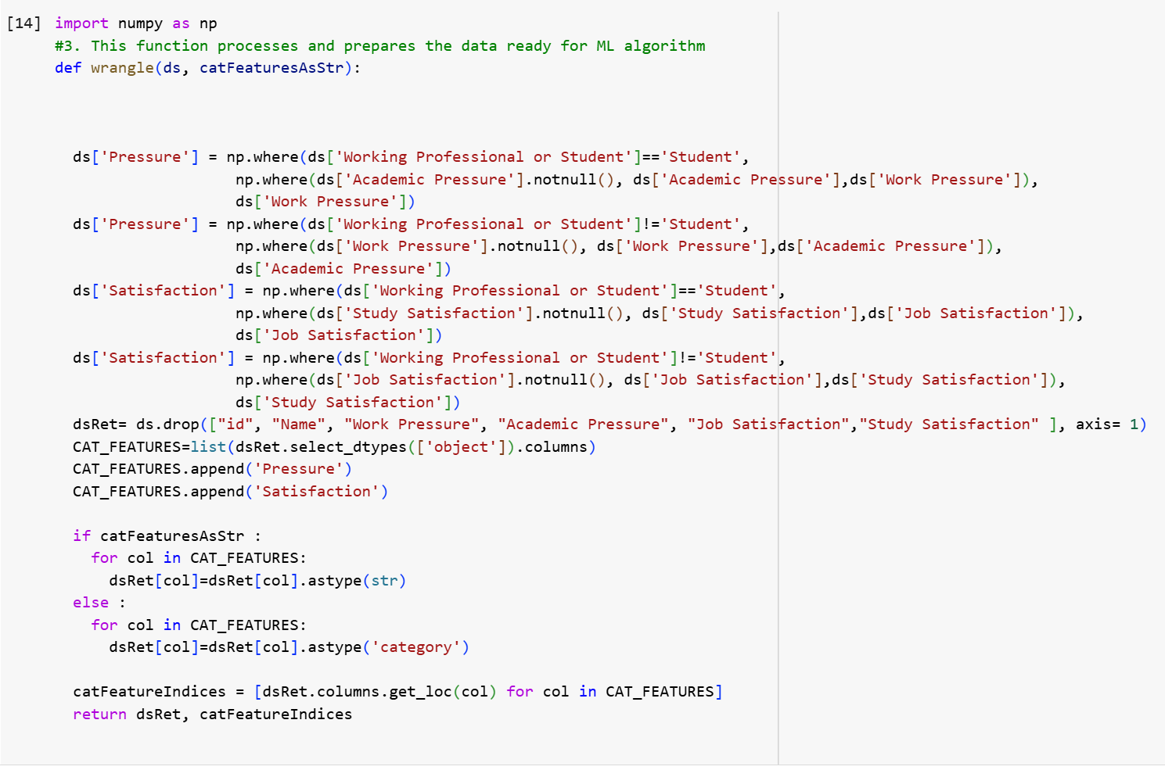
Data Preprocessing
Merged the academic and work
pressure features
Merged the Job and study satisfaction
features
Removed the ID , name features
Cast the datatypes of the categorical
features as needed for the algorithms

Slide 10
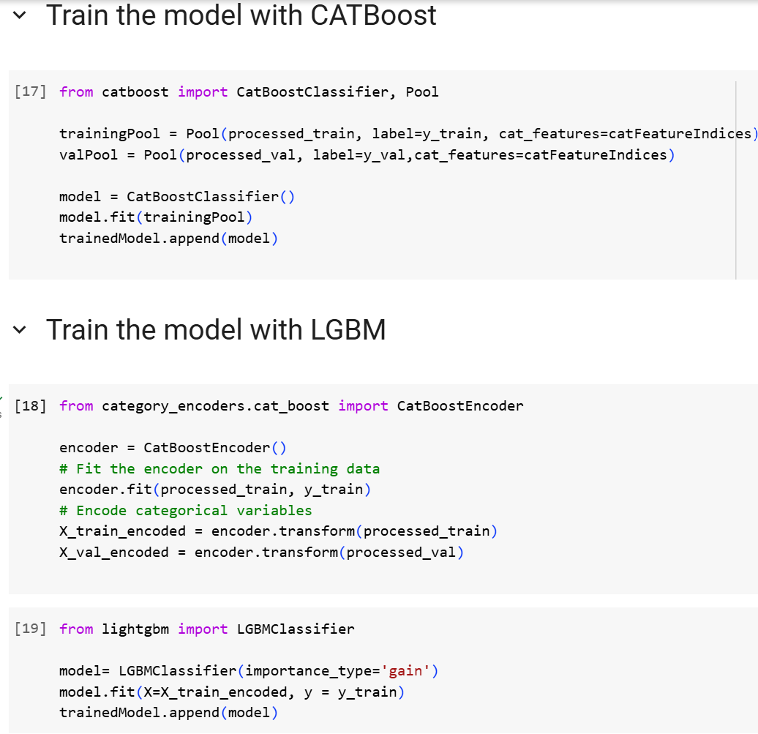
Model Selection
CATBoost and Light Gradient boosting algorithms are the well suited algorithm for this classification problem with high cardinality features because dataset has,
high cardinality categorical data
using hot / label encoders will lead to sparse matrix
Training and test data
Used Train test split from sklearn library to prepare training data and validation data.

Slide 11
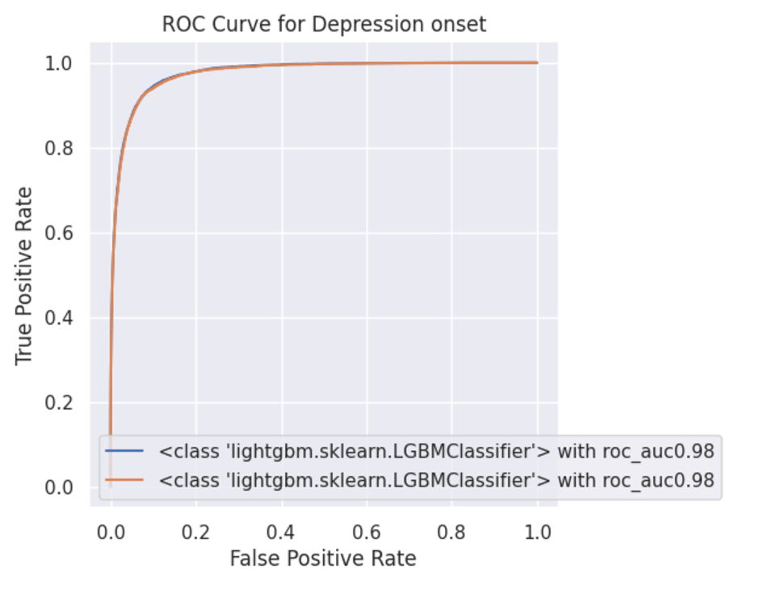
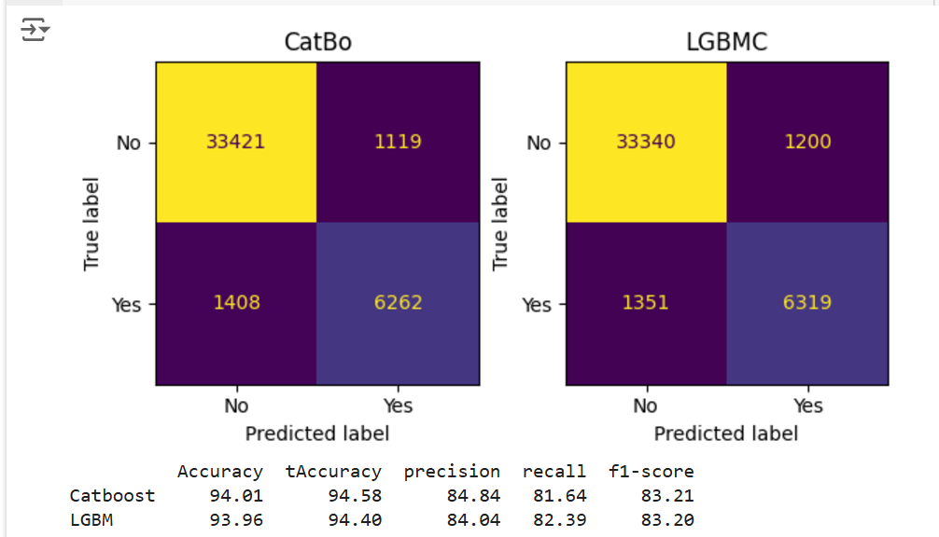
Classification metrics and ROC curve

Slide 12
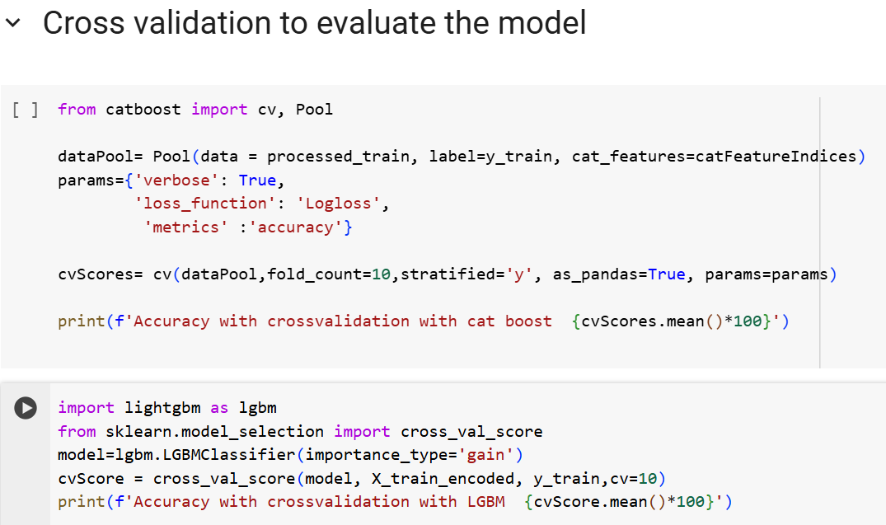
Cross validation
Cross validation with 10 folds gave similar results to the trained model meaning there isn't much variation in the accuracy between different samples.

Slide 13
Hyperparameter Tuning
import optuna
from sklearn.metrics import classification_report
def Objective(test):
params = {
"iterations": 1000,
"learning_rate": test.suggest_float("learning_rate", 1e-3, 0.1, log=True),
"depth": test.suggest_int("depth", 1, 10),
"colsample_bylevel": test.suggest_float("colsample_bylevel", 0.05, 1.0),
"min_data_in_leaf": test.suggest_int("min_data_in_leaf", 1, 100),
}
trainingPool = Pool(X_train, label=y_train, cat_features=catFeatureIndices)
valPool = Pool(X_val, label=y_val,cat_features=catFeatureIndices)
catModel= CatBoostClassifier(**params, silent=True)
catModel.fit(trainingPool)
pred=catModel.predict(valPool)
report= classification_report(y_val, pred, output_dict=True)
print(report)
f1score=report['0']['f1-score'] #Focus on false nagative
accuracy = accuracy_score(y_val,pred)
return accuracy
study = optuna.create_study(directions=['maximize'])
study.optimize(Objective, n_trials=30)
Optuna is an open source library that automates the process of finding optimal hyperparameters for machine learning and deep learning models.
Defined an objective function and the number of trials involved as param to optimize on the model parameters.
A study with the objective is created which focuses on optimizing the objective functions return value, which is accuracy in this case.

Slide 14
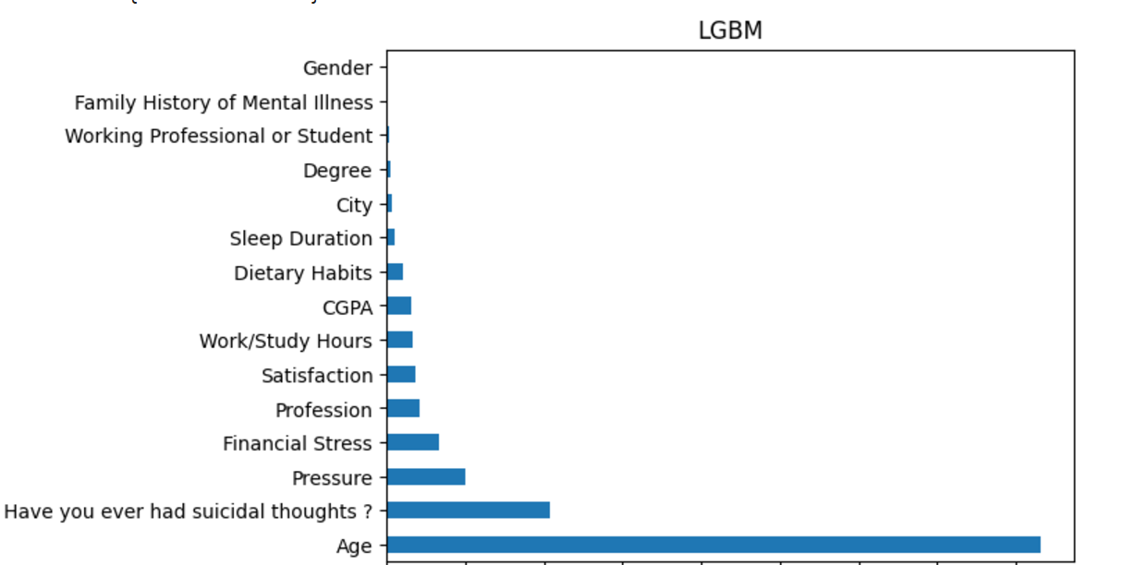
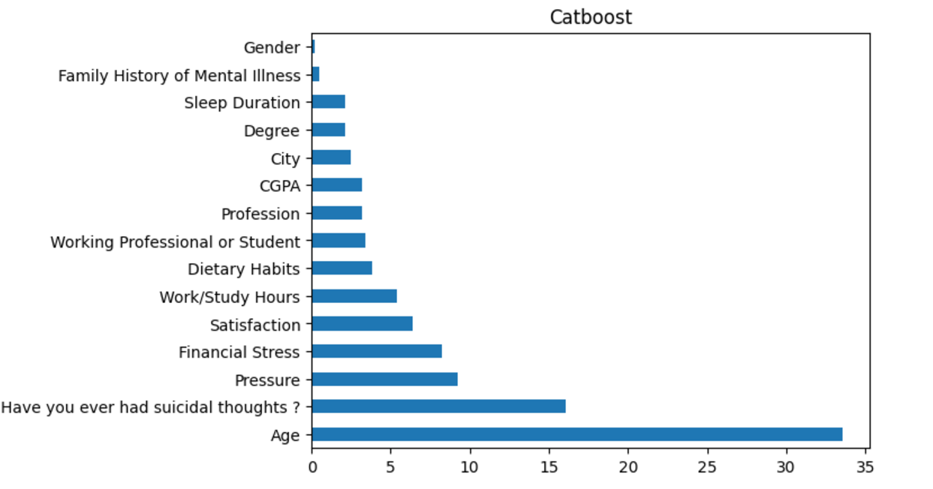
Feature Importance

Slide 15
Conclusion
Machine learning algorithm, CATBoost is well suited for this problem with 94% accuracy.
Age , Suicidal thoughts, financial, work and acdaemic stress are the primary factors that contribute to the onset of depression.
With the insights from mental health predictions,
Government Policymakers: Allocate resources, develop policies, and prioritize mental health in public agendas.
Public Healthcare Systems: Set up early intervention programs and enhance crisis intervention services.
Organizations: Establish mental health support programs and wellness initiatives to reduce stress.
Educational Institutions: Set up mental health clubs, offer stress reduction programs, and promote mental health literacy.

Slide 16
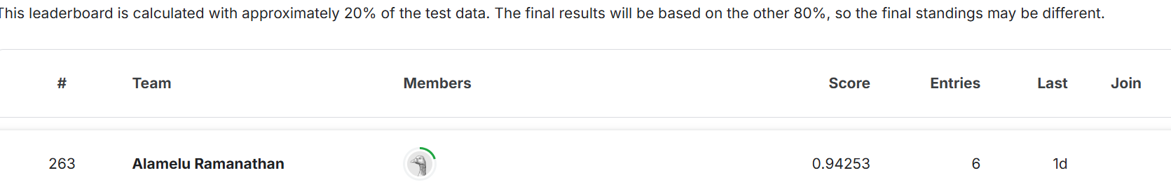
Kaggle and further enhancements due…
These are the further enhancements inline to improve the accuracy of the model,
Feature engineering, merging, the satisfaction columns together
and pressure columns together
Scaling the numerical features like Age, CGPA and study hours.
Binning the feature variables like Age
Converting all the noise data to one ‘unknown’ category.
Finding the optimal threshold value for the classification.

Slide 17

Alamelu Ramanathan
alamurm@gmail.com

